Slide 1

Bus service adjustment under the drivers' infection outbreak in Singapore
Leveraging Urban big data and Spatial Interaction Coverage Model
Authors（
Su Lixian, Wang Haoran, He Zhiyin, Liao Nan, Liu Zhaoyin, Luo Wei
Geography Department
National University of Singapore
1st Workshop of Asian young geographers Dec 18, 2021

Slide 2
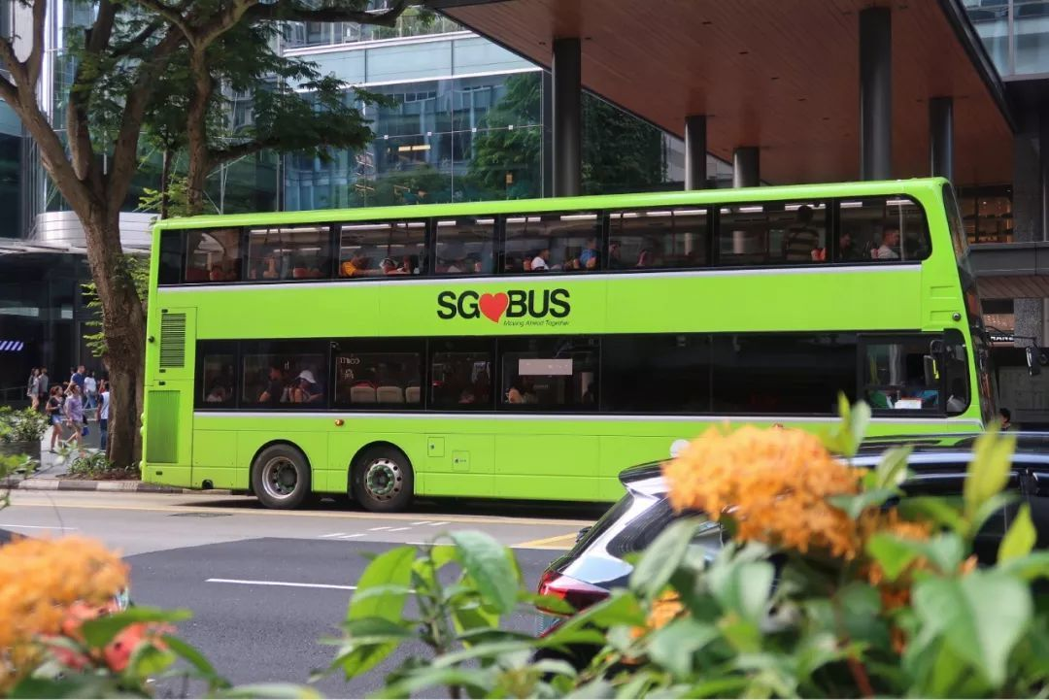

CONTENTS
01
02
03
04
05
06
Introduction
Data
Methodology
Analysis
Results
Conclusions

Slide 3


Introduction
Background
The outbreak of COVID-19 affects all aspects of people's lives
Transportation, especially public transport, is one of the most severely affected aspects due to this epidemic.
The outbreak of bus driver infection clusters in Singapore
Outbreak of infection clusters at bus interchanges in eight regions
Confirmed bus drivers reach more than 600.
！Challenges occurred
Due to COVID-19 and loss in driver manpower, the LTA had to make adjustments for bus routes. It has been announced that some bus headways will be lengthened.
3

Slide 4
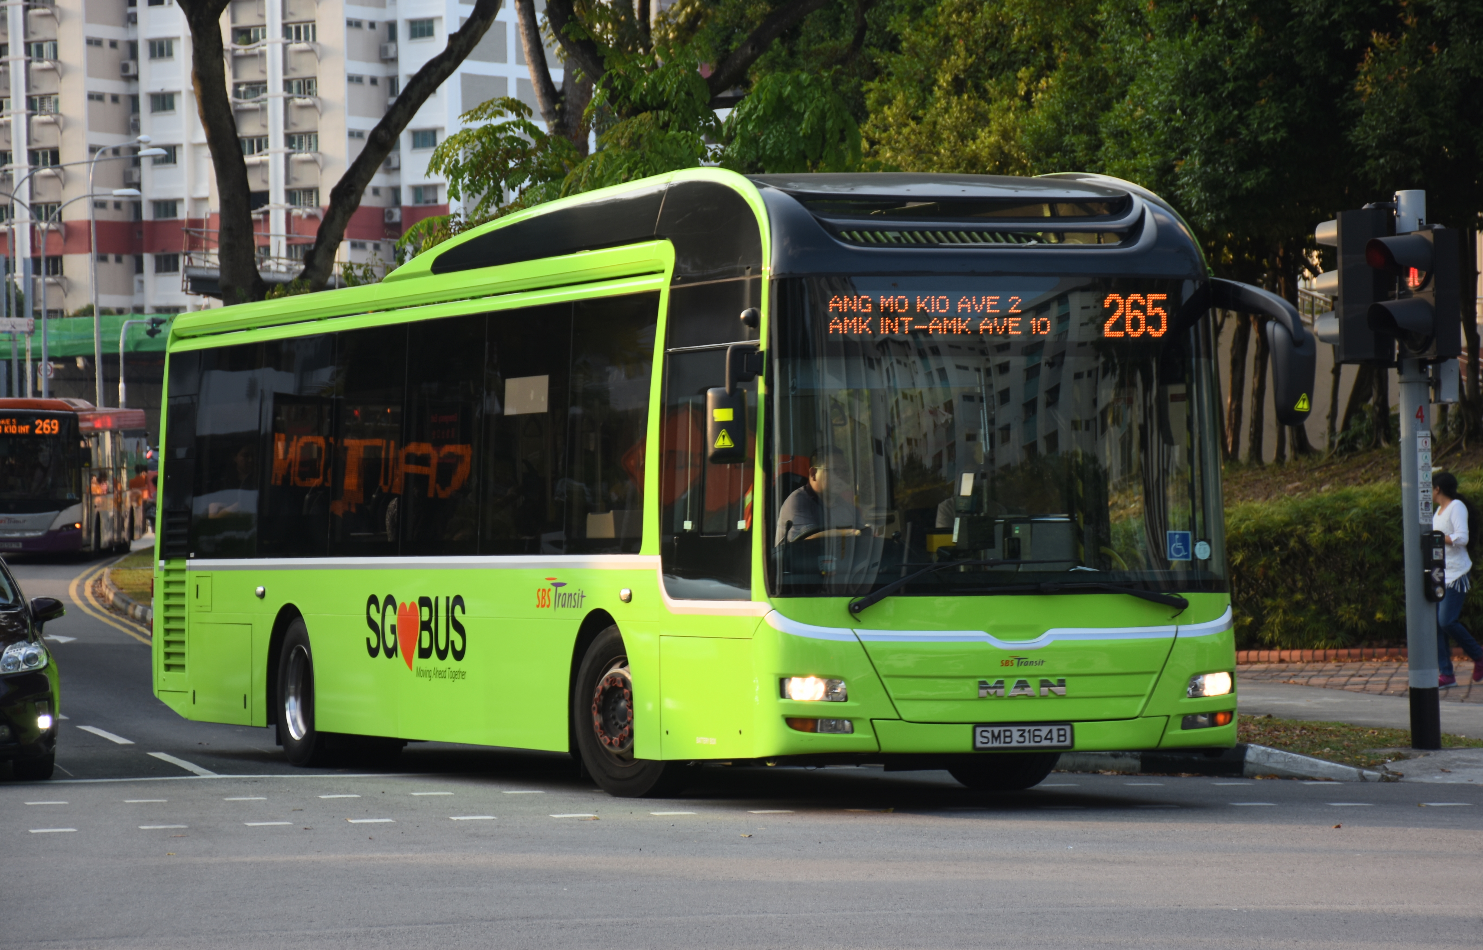



Introduction
Objective
Provide bus service optimization advice for policy makers
Develop an evaluation system that quantifies the influence of multiple different bus routes in a given study area.
4

Slide 5
Data
5

Slide 6
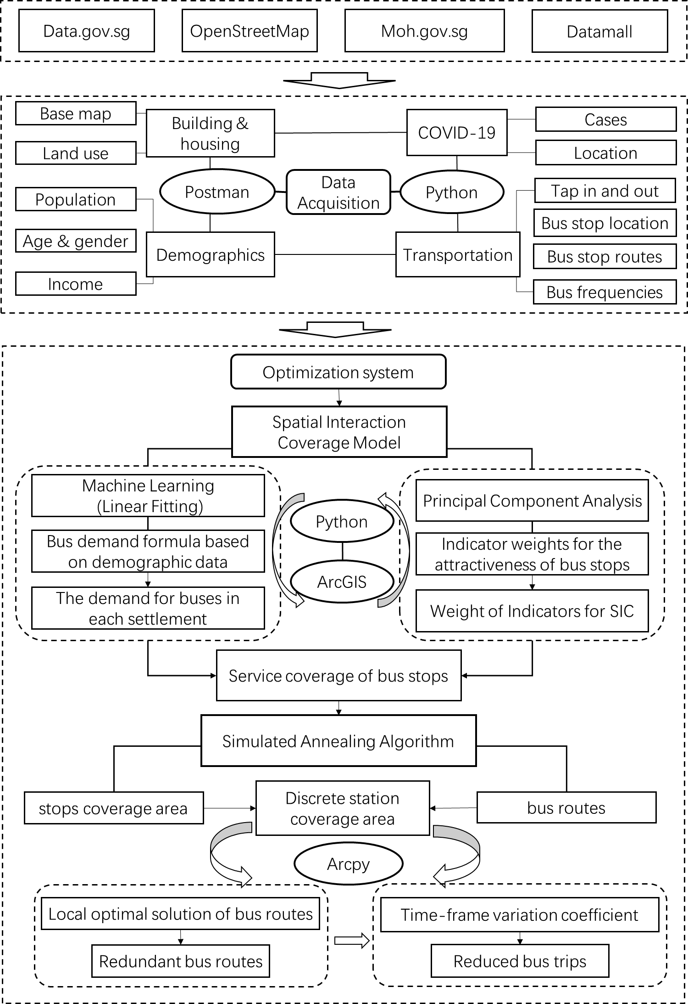
Methodology
Workflow
6

Slide 7

Methodology
Determine the weights
1
We are going to use PCA to determine the weight of attractiveness of bus stations.
Spatial Interaction Coverage Model (SIC)
2
SIC model is a kind of modifying Huff model. We
try to utilize SIC to estimate the coverage of bus
stations in Singapore.
Simulated Annealing Algorithm (SA)
3
A kind of optimizing algorithm. We try to use minimum bus resources to achieve maximum bus service coverage.
The methods we use
7

Slide 8
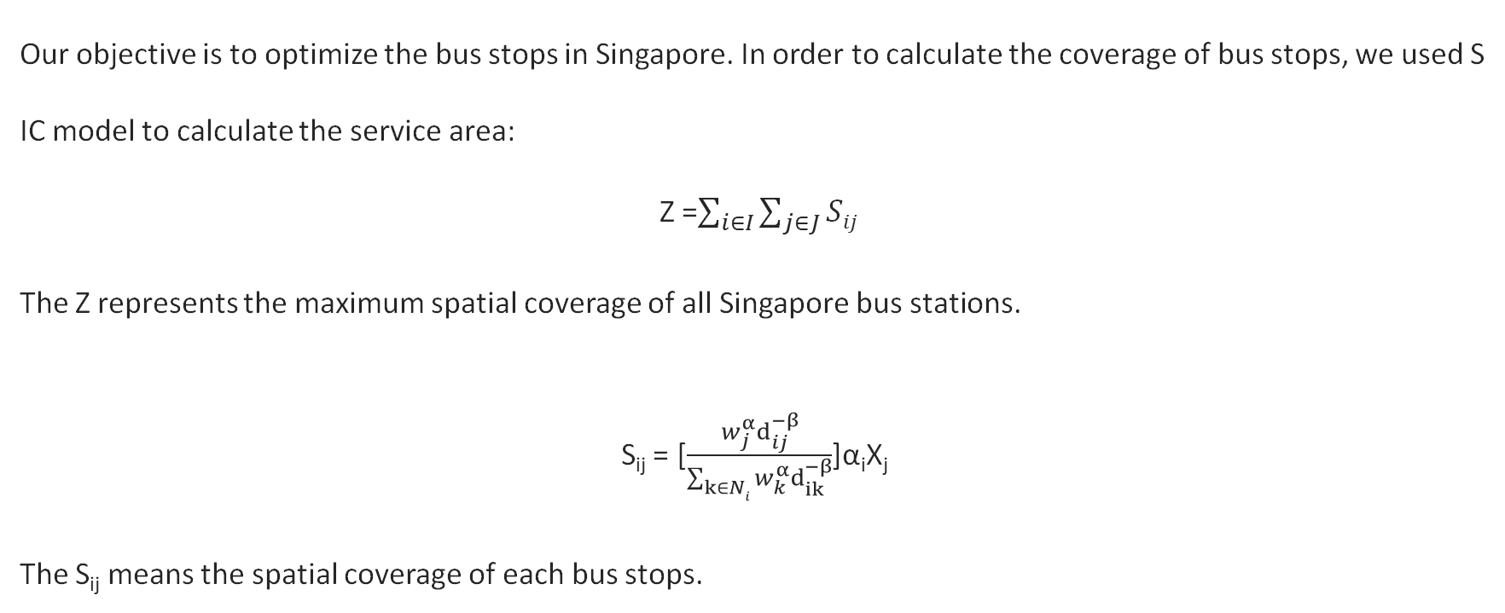
Analysis
Spatial Interaction Coverage Model (SIC)
Our objective is to optimize the bus stops in Singapore. In order to calculate the coverage of bus stops, we used SIC model to calculate the service area:
Z =$\sum_{i∈I}{\sum_{j∈J}{Sij}}$
The Z represents the maximum spatial coverage of all Singapore bus stations.
S_{ij} = [$\frac{w_{j}^{α}d_{ij}^{−β}}{\sum_{k∈Ni}{w_{k}^{α}d_{ik}^{−β}}}$]α_{i}X_{j}
The S_{ij} means the spatial coverage of each bus stops.
8

Slide 9
Analysis
Spatial Interaction Coverage Model (SIC)
i = index of demand nodes I = collection of demand nodes
j, k = index of bus stops J = collection of all bus stops
w_{j} = attractiveness of bus stop j α_{i} = demand at location i
d_{ji} = shortest accessing distance between demand node I and candidate bus stop j
N_{i} = a set of candidate bus stops within the willingness-to-walk distance
X_{j} = ⇢ 1(if existing candidate bus stop j is selected)
0(otherwise)
S_{ij} = spatial interaction between demand node i and candidate bus stop j
9

Slide 10
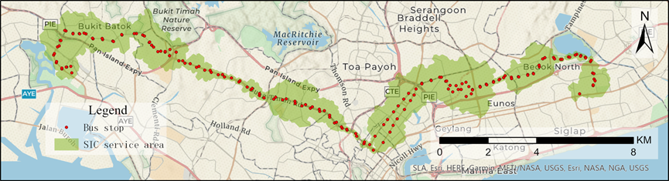
Analysis
Analysis of bus stop service area by SIC model
The SIC service area can display the bus stop coverage of each bus line
SIC service area for bus line 66
10

Slide 11
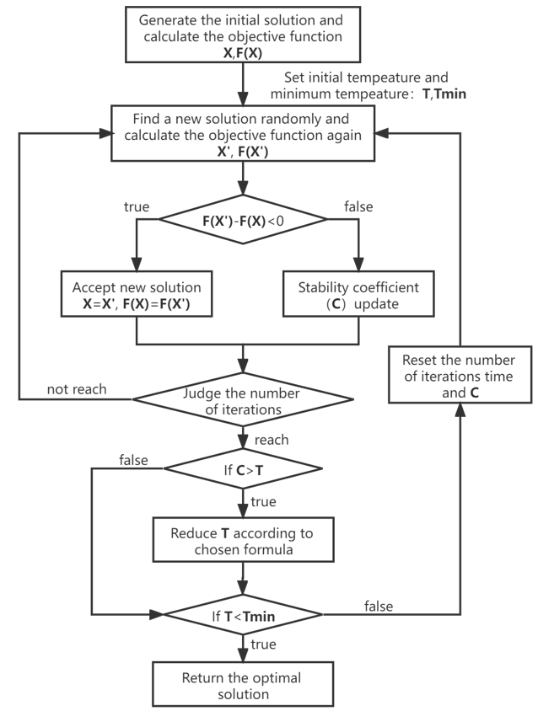
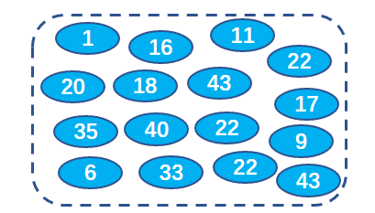

Analysis
What can Simulated Annealing do ?
SA algorithm structure
If we use SA:
Not only will the calculation time be faster, but the confidence of the results will still be higher
* 40 elements
Extract 10 elements with the maximum sum
If we try one by one, we need:
Temperature control parameter
$C_{40}^{10}$=847,660,528
times
11

Slide 12
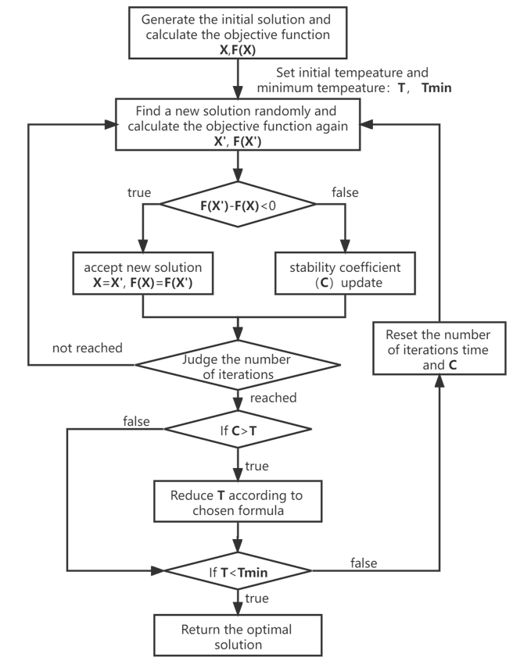

Analysis
How SA is used in this project
Specific spatial analysis process
166
963
143
Our F(X)
188
Random Select
201
121
96
Remove Select
33
166
NR6
Dissolve Remaining SIC Area
Remove X bus route and calculate remaining SIC service area
Calculate Area
12

Slide 13
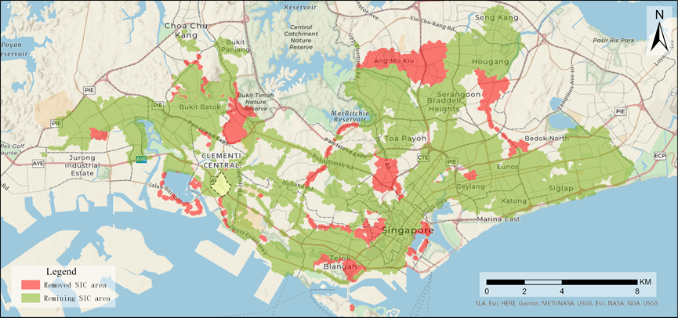

Analysis
Select the bus route to be adjusted by SA algorithm
After the bus route adjusted by SA algorithm, the SIC coverage will be altered
The optimal remaining SIC area in Clementi Central after 20 bus lines were removed
13

Slide 14
Analysis
Time variation analysis of passenger flow
Rank comprehensive comparison by Variation Coefficient (Temporal)
Average tap in/out data for each stop
reflect the total passenger capacity level of each route
Variation Coefficient (Temporal)
reflect the trend in the distribution of ridership at each station over time
Identify lines that can reduce the frequency of service
Compare the ranking in different subzones.
Determine the best time slots to reduce the frequency of service
14

Slide 15
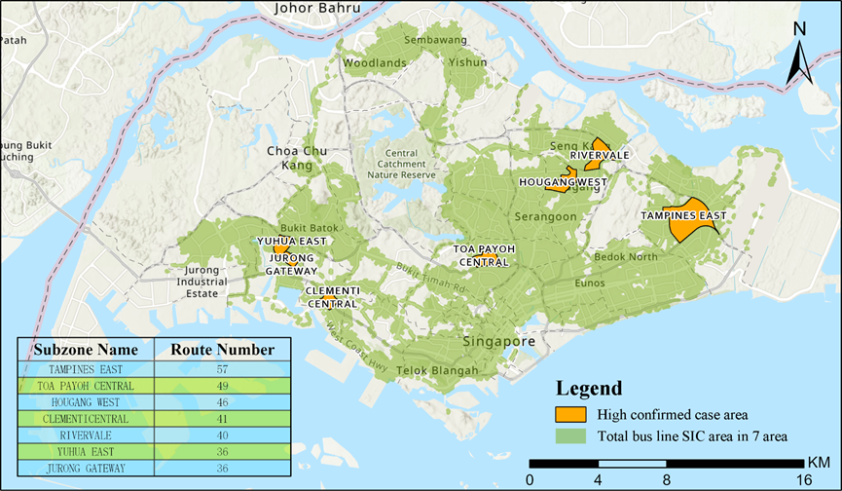
Results
Selected subzones for further analysis
Bus Driver Infection Cluster | Cases
Toa Payoh bus transfer station | 203
Clementi bus transfer station | 53
Bishan Bus Terminal | 38
Sengkang Bus Terminal | 28
Jurong East Bus Terminal | 43
Punggol bus interchange | 41
Tampines bus interchange | 55
Boon Lay Bus Interchange | 165
Bus driver infection clusters
7 subzones for further analysis
15

Slide 16
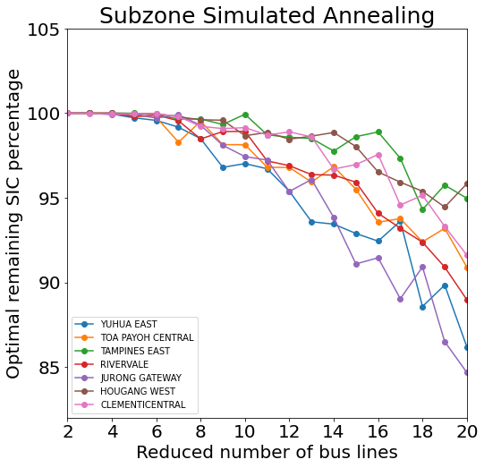
Results
Select the bus lines to be adjusted by SA algorithm
Adjustment of 10 bus lines of each subzone
Correspond to the most efficient bus stop SIC coverage
SA result of bus lines in 7 subzones
16

Slide 17
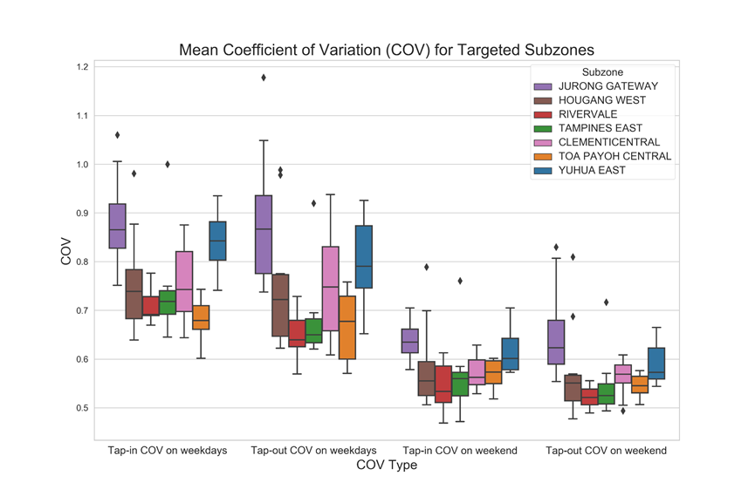
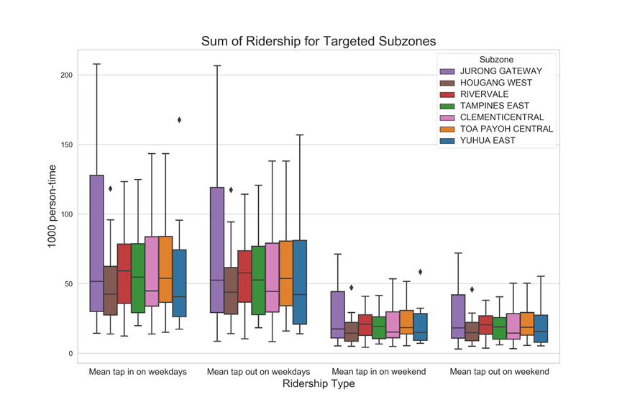
Results
Bus service frequency adjustment scheme
——based on time variation coefficient and ridership
Mean
Coefficient of variation of ridership on weekdays (tap in/out)
Coefficient of variation of ridership on weekends (tap in/out)
Sum
Average ridership per stop on weekdays (tap in/out)
Average ridership per stop on weekends (tap in/out)
17

Slide 18
Results
Bus service frequency adjustment scheme
——based on time variation coefficient and ridership
Extremely low average ridership
during all hours on weekdays and weekends
High variation coefficient
during off-peak hours, and for weekends as well.
Extremely high average and low variation coefficient
not adaptable to reducing the frequency of departures at any time.
Example bus adjustment scheme (TAMPINES EAST)
18

Slide 19
Results
Bus service frequency adjustment scheme
——based on time variation coefficient and ridership
19

Slide 20



Conclusions
What we finally achieved?
An adjustment plan for the frequency of bus services in the subzones most affected by the bus driver infection cluster
Four ArcGIS scripting tools based on the SIC model and SA algorithm
A way to improve the efficiency of the entire bus system
A new research perspective with the whole line as the research object
20

Slide 21
References
[1] "Coronavirus: Singapore ups outbreak alert to orange as more cases surface with no known links; more measures in force". The Straits Times. 7 February 2020.
[2] "PM Lee Hsien Loong on the COVID-19 situation in Singapore on 3 April 2020". PMO. 3 April 2020. Retrieved 4 April 2020.
[3] LTA | LTA Media Statement on Recent Bus Interchange Clusters
[4] https://www.moh.gov.sg/covid-19/past-updates
[5] Tan, C. (10 February 2021). Bus, train ridership in Singapore falls to 11-year low amid Covid-19 pandemic. The Straits Times.
[6] LTA | LTA Media Statement on Recent Bus Interchange Clusters
[7] LTA | LTA and PTOs: Joint Media Release on Bus Service Frequency
[8] Chen, Y., Bouferguene, A., Shen, Y., & Al-Hussein, M. (2019). Assessing accessibility-based service effectiveness (ABSEV) and social equity for urban bus transit: A sustainability perspective. Sustainable Cities and Society, 44, 499-510.
[9] Eric M Delmelle, Shuping Li, and Alan T Murray. 2012. Identifying bus stop redundancy: A gis-based spatial optimization approach. Computers, Environment and Urban Systems 36, 5 (2012), 445–455
[10] Alan T Murray and Xiaolan Wu. (2003). Accessibility tradeoffs in public transit planning. Journal of Geographical Systems 5(1), 93–107.
[11] Liang, Y., Gao, S., Wu, T., Wang, S., & Wu, Y. (2018, November). Optimizing bus stop spacing using the simulated annealing algorithm with spatial interaction coverage model. In Proceedings of the 11th ACM SIGSPATIAL International Workshop on Computational Transportation Science (pp. 53-59).
[12] David L Huff. 1963. A probabilistic analysis of shopping center trade areas. Land economics 39, 1 (1963), 81–90
[13] Vincent Chakour and Naveen Eluru. 2016. Examining the influence of stop level infrastructure and built environment on bus ridership in Montreal. Journal of Transport Geography 51 (2016), 205–217.
[14] Zhou, Jibiao & Ma, Changxi & dong, sheng & zhang, mingjie. (2020). Unconventional Prevention Strategies for Urban Public Transport in the COVID-19 Epidemic: Taking Ningbo City as a Case Study. 33(11), 1-11
[15] Zhang Yi, Wang Xue-cheng, BI Qing-hua. (2020). Travel-infected Susceptibility Based on Transmission Mechanism of COVID-19. Transport Research, 6 (1): 73-80
[16] Gkiotsalitis, K., & Cats, O. (2021). Public transport planning adaption under the COVID-19 pandemic crisis: literature review of research needs and directions. Transport Reviews, 41(3), 374-392.
[17] Gkiotsalitis, K., Wu, Z., & Cats, O. (2019b). A cost-minimization model for bus fleet allocation featuring the tactical generation of short-turning and interlining options. Transportation Research Part C: Emerging Technologies, 98, 14–36.
[18] Gkiotsalitis, K., & Cats, O. (2021). Optimal frequency setting of metro services in the age of COVID-19 distancing measures. Transportmetrica A: Transport Science, 1-21.
[19] Steinbrunn M, Moerkotte G, Kemper A. Heuristic and Randomized Optimization for the Join Ordering Problem [J]. The VLDB Journal, 1997, 6 (3) :8 - 17.
[20] Vladimír Černy. 1985. Thermodynamical approach to the traveling `salesman problem: An efficient simulation algorithm. Journal of optimization theory and applications 45, 1 (1985), 41–5
[21] Tatyana Valentinovna Levanova and MA Loresh. 2004. Algorithms of ant system and simulated annealing for the p-median problem. Automation and Remote Control 65, 3 (2004), 431–438
[22] Murray, A. T., & Church, R. (1996). Applying simulated annealing to location-planning models. Journal of Heuristics, 2, 31–53
[23] Wang, Chao; Ye, Zhirui; Chen, Enhui; Xu, Mingtao; Wang, Wei (2019). Diffusion approximation for exploring the correlation between failure rate and bus-stop operation. Transportmetrica A: Transport Science,1–15.

Slide 22
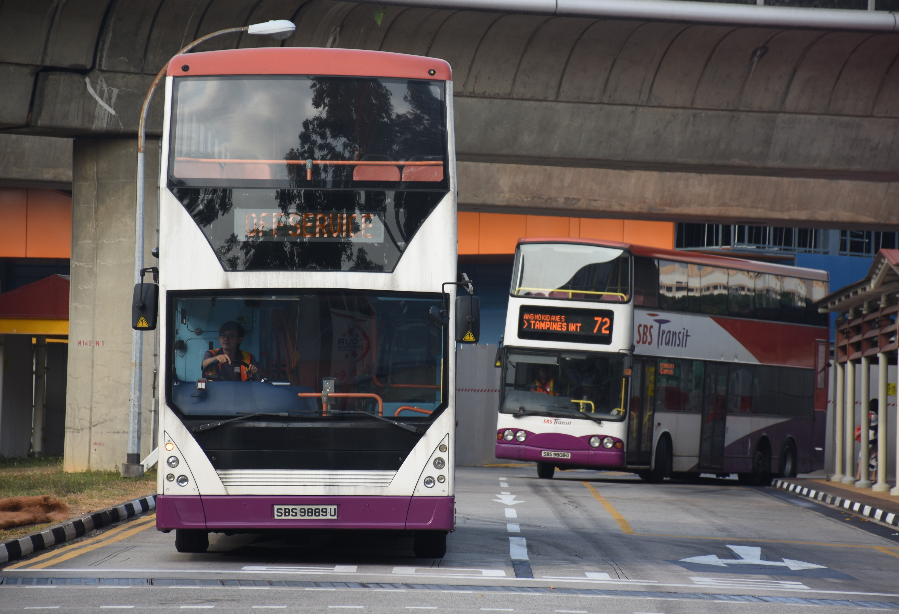
THANK YOU!

Slide 23
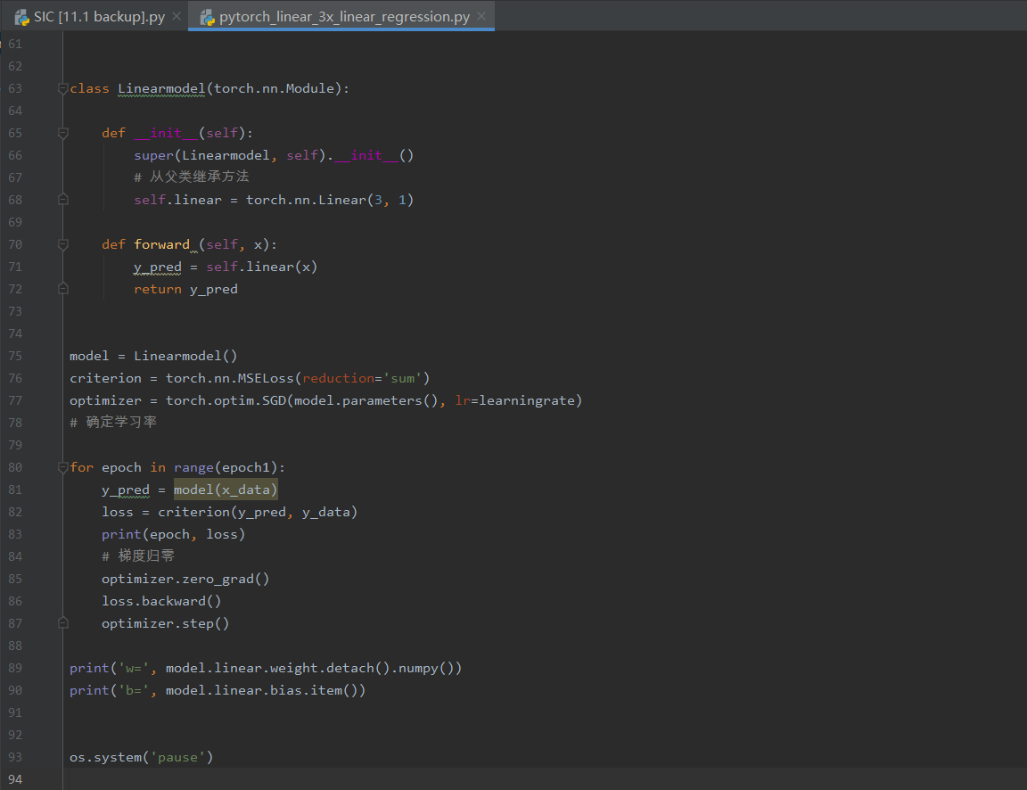
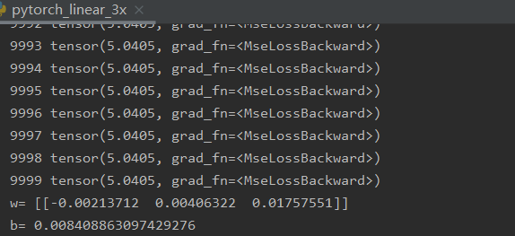
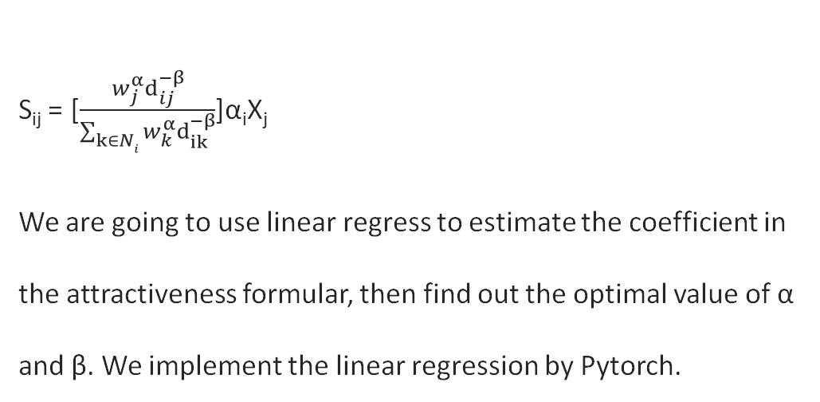
Analysis
Spatial Interaction Coverage Model (SIC)
About the α and β in SIC
S_{ij} = [$\frac{w_{j}^{α}d_{ij}^{−β}}{\sum_{k∈Ni}{w_{k}^{α}d_{ik}^{−β}}}$]α_{i}X_{j}
We are going to use linear regress to estimate the coefficient in the attractiveness formular, then find out the optimal value of α and β. We implement the linear regression by Pytorch.
a_{i} = a * P_{i} +b * I_{i} + c * A_{i}
23
23

Slide 24
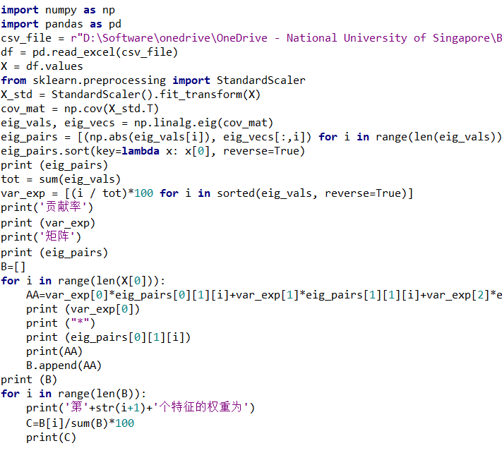
Analysis
Determine the weights
About the attractiveness of bus stops, we will consider a
variety of parameters. Such as the route diversity, residential areas, and shopping malls, etc. We will use PCA to determine the weights of each parameter. Then we will aggregate all
parameters to represent the attractiveness of each bus stops.
(PCA result has passed the KMO test).
24

